Slide 1
A Kingdom view of
Missions

Slide 2
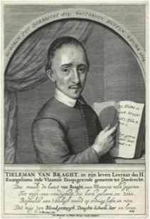
Introduction to the Martyrs Mirror
“These are sad times, in which we live; nay, truly, there is more danger now than in the time of our fathers, who suffered death for the testimony of the Lord. Few will believe this, because the great majority look to that which is external and corporeal, and in this respect it is now better, quieter and more comfortable; few only look to that which is internal and pertains to the soul, and on which everything depends,
‘for what is a man profited, if he shall gain the whole world, and lose his own soul? or what shall a man give in exchange for his soul?’" Matt. 16:26.

Slide 3
It grieves us to the heart that we must live to see these times, and therefore speak in this wise. O Lord, strengthen our faith! help Thy weak, trusting lambs, that they may not be led into error, nor moved from the foundations of the most holy faith.
On the other hand, through his instigation, the world now reveals itself very beautiful and glorious, more than at any preceding time, in a threefold pleasing form-the lust of the flesh, the lust of the eye, and the pride of life. Almost all men run after her, to worship her as a queen supreme; but all are deceived thereby; yea, many who have drunk of the poisoned wine of her lusts from the golden cup of her iniquities and deceptions, die a spiritual death.
As the first design is aimed at the faith, so this is directed against the true Christian life. Here lies great danger. Who shall escape these snares? He that would at no time be taken unawares by it, must indeed be cautious and watchful. But our very flesh seems prone to it. Here must be fasting, watching, praying, and calling upon God for help, otherwise there is no escape.

Slide 4
What would you have done on January 22, 1525?

Slide 5
My thoughts on Anabaptist Mission history
I wonder if some of the reasons for the typical tension in Anabaptist churches between church and mission comes from the fact that they should have never have been separated in the first place.
Everywhere we have churches without missions and everywhere else we have missions without churches and this should have never been.
Why are American Anabaptists adopting modern Evangelical methods of missions just at a time when the Evangelicals have started to discard them?

Slide 6
What I see in New Testament/ pilgrim/ Anabaptist church history:
The Message
The Method
Jesus
Church

Slide 7
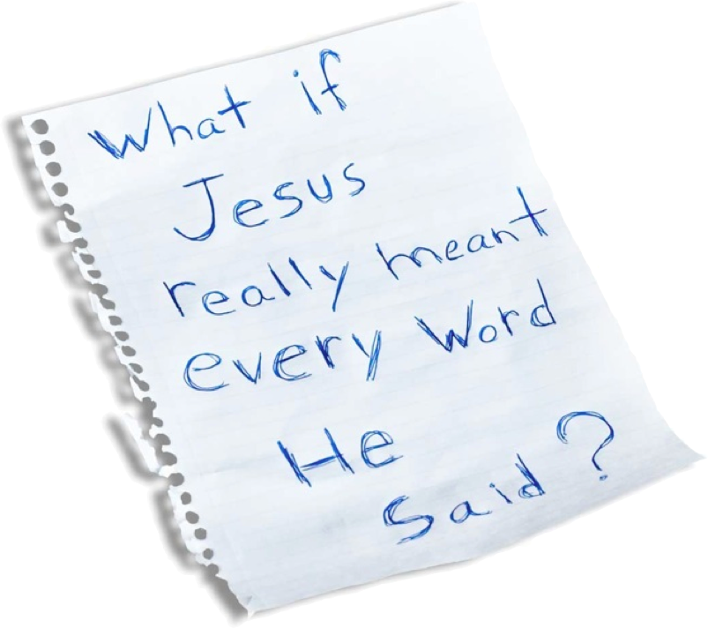
The Message

Slide 8
The Message
“All things”
Christ centered....Christ manifested... not just WWJD?, but DWJD!
Kingdom now....and not yet.
I am suspicious of any doctrine that changes over seas...or over centuries.

Slide 9
The Method
The Church
Not an invisible Church, but as Christ came in both the spirit and the flesh, so the “body of Christ” today must be both spirit and flesh.
Church is not an accident
A called out community (gemeinde) of committed -born again believers.
A city in the kingdom of God
“On earth as it is in heaven”

Slide 10
NO GO NO LO
“The primary historical significance of the Great Commission lies in the fact that it gives to the church the pattern and purpose of missions. It defines and delineates the missionary task. We have in the Great Commission a compass, a charter, and a plan.”
Dave Harvey Missiology: Entering the Field of the Lord
“And Jesus came and spake unto them, saying, All power is given unto me in heaven and in earth. Go ye therefore, and teach all nations, baptizing them in the name of the Father, and of the Son, and of the Holy Ghost: Teaching them to observe all things whatsoever I have commanded you: and, lo, I am with you always, even unto the end of the world. Amen.” (Matthew 28:18-20)

Slide 11
Conservative Evangelicals are starting to say it....
When Christ said, “I will build my church” (Mt 16:18), he wasn’t planting a permanent ego-boost in the pages of Scripture so we could all feel good about our churches. It was a grand mission declaration! Missiologist Aubrey Malphurs (DTS)writes:
A careful reading of Acts reveals that the early church implemented the Great Commission mandate primarily by planting churches. A study of the missionary journeys recorded in Acts reveals that they, in fact, were church-planting forays into what was predominantly a pagan culture. As a result of these trips, Paul and others planted high- impact churches in key cities such as Derbe, Lystra, Iconium, Antioch, Philippi, Thessalonica, Berea, Corinth, and Ephesus.
Armed with the good news, we are commanded to follow the New Testament pattern of penetrating new regions to communicate God’s Word and create God’s community. In contrast to traditional missionary enterprises, which often center primarily upon proclamation, church planting establishes a mission base for the three-fold purpose of proclamation (going and baptizing), integration (making disciples/teaching), and expansion (reproducing proclamation and integration in the new geographic area).
The message proclaimed is the gospel, the context for integration is the church, and mobilizing a “gospelized” church produces expansion: local churches reproduce themselves.

Slide 12
Dave Harvey wrote, “Sad to say, Christians in western culture, with its emphasis on individual vision and personal spirituality, often erase the Local Church factor from the equation:”
The Gospel
+
The Commissioned Individual
=
World Evangelization

Slide 13
A New Testament application of the Great Commission should therefore look like this:
The Gospel
+
The Commissioned Individual
+
The Local Church Community
=
World Evangelization

Slide 14
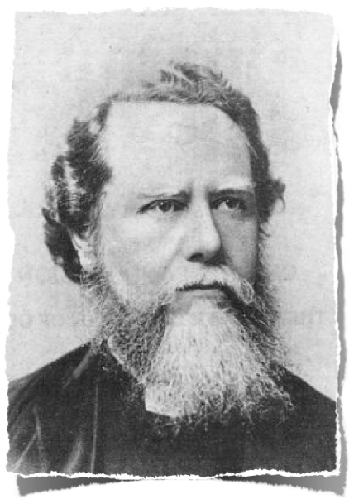
As George Peters has noted, “The history of the church in missions is in the main the history of great personalities and of missionary societies. Only in exceptional cases has it been the church in missions.”
Roland Allen once said, “We cannot but recognize that everywhere we have established missions, and missions are not churches....If we establish missions instead of establishing churches it is because we differ from the apostles and the early Church in principle and
in spirit.”
Hudson Taylor

Slide 15
Where’s the Church?
It’s not enough simply to preach the gospel and see people converted. The Great Commission is fully satisfied only when converts become anchored in their faith, instructed in the context of the local church, and equipped as ambassadors of Christ. That is, made disciples.
This brings us far closer to the New Testament way. The idea is not so much that individuals are to be sent out from the local church. Rather, they are sent out as expressions of the local church. In that sense, the local church sends itself—its gifts, values, maturity, and resources are reproduced in another location in a way that uniquely fits the context where it is planted. Because church planting exports biblical community rather than church traditions narrowly defined, it works across town or across cultures.

Slide 16
Paul Tripp laments the loss of a full commission.
“I believe that the church has been weakened by its tendency to neglect the second half of this commission. Jesus calls us not only to go and make disciples, but also to teach them what it means to live lives that are obedient to every command of Christ. It is a call to exhort, encourage, and teach so that we would be progressively freed from old patterns of sin and conformed instead to the image of Christ. The Great Commission is not only a call to bring people into the kingdom of light, but also a call to teach them to live as children of light once they are there. When we lose sight of this second half of the Great Commission (‘teaching them to obey everything I have commanded you’), we lose sight of its claim on our everyday talk.” Paul David Tripp, War of Words (Phillipsburg, NJ: P&R Publishing, 2000) p 171

Slide 17
“Everywhere we have churches without missions and everywhere else we have missions without churches.”
George Peters said,“The church is God’s creation for the observance of the divine ordinances, and it is God’s institution for teaching purposes. Since the church is the pillar and ground of truth, the Great Commission falls principally upon her. She inherits the Great Commission from the apostles of Christ and becomes responsible for its realization. Too long has pietistic individualism dominated the mind and scene of Protestantism in relation to the Great Commission while the church was left asleep.” (A Biblical Theology of Missions, pp 220–221)

Slide 18

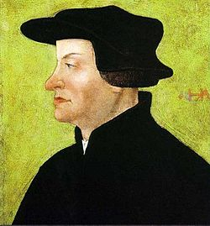
Fundamentally wrong from the beginning!
“The misconception that missions was the responsibility of individuals rather than the obligation of the churches. This erroneous idea, advocated by Zwingli and his successors, has only gradually and in part been overcome in recent decades. Zwingli maintained that missions is the business of specially called apostles, and that the church as such has nothing to do with missions. This same idea carried over later into Pietism and became dominant in much of Western Protestantism. It still survives due to the inertness of many churches and their inability to organize effectively for missions on the one hand and the strong and vital individualism of some leaders on the other hand.”
(George Peters A Biblical Theology oF Missions, pp 216–217)

Slide 19
Did he just say what I think he said?
“This erroneous idea, advocated by Zwingli and his successors...”
Why are the Anabaptists of America adopting old Evangelical methods of missions, just at a time when the Evangelicals themselves have started discarding them?

Slide 20
What would you have done on January 22, 1525?

Slide 21
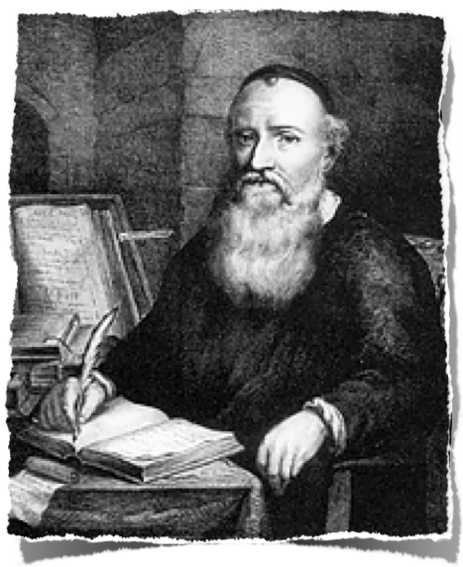
Preach everywhere!
• Menno Simons said, “Therefore we preach, as much as is possible, both by day and by night, in houses and in fields, in forests and wastes, hither and yon, at home or abroad, in prisons and in dungeons, in water and in fire, on the scaffold and on the wheel, before lords and princes, through mouth and pen, with possessions and blood, with life and death.... We could wish that we might save all mankind from the jaws of hell, free them from the chains of their sins, and by the gracious help of God add them to Christ by the Gospel of his peace. For this is the true nature of the love which is of God.”
A citizen of Heilbronn testified before a court in 1539 that prior to his baptism he had fled from the Anabaptists as from the devil himself, because of the fervent energy with which they sought to persuade him.

Slide 22

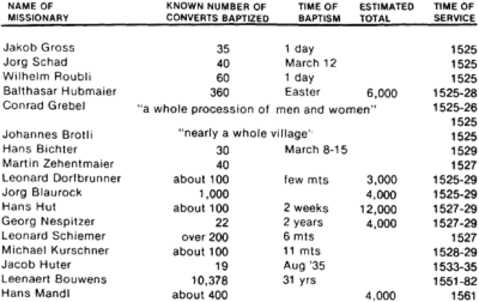
ZEAL FOR SOULS!

Slide 23
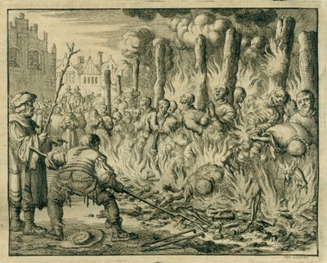
The Martyrs Synod
At the Martyrs Synod, there was planned a systematic sending of missionaries. The designation “apostles” was deliberately chosen for those who were sent out in apostolic teams of three to specific places for the sole purpose of evangelism and church planting. Hans Hut, one of the chairmen of the 1527 missionary conference in Augsburg, had already sent apostles to many parts of Europe.
The sending Church of Augsburg shared the conviction of the missionaries and urgently called for commitment to evangelism. Within two weeks from the end of the conference on August 24 to the issuance of a new mandate by the Augsburg authorities against the Anabaptists on September 6, the Augsburg church sent out more than two dozen missionaries to strategic centers in Germany and Austria.

Slide 24
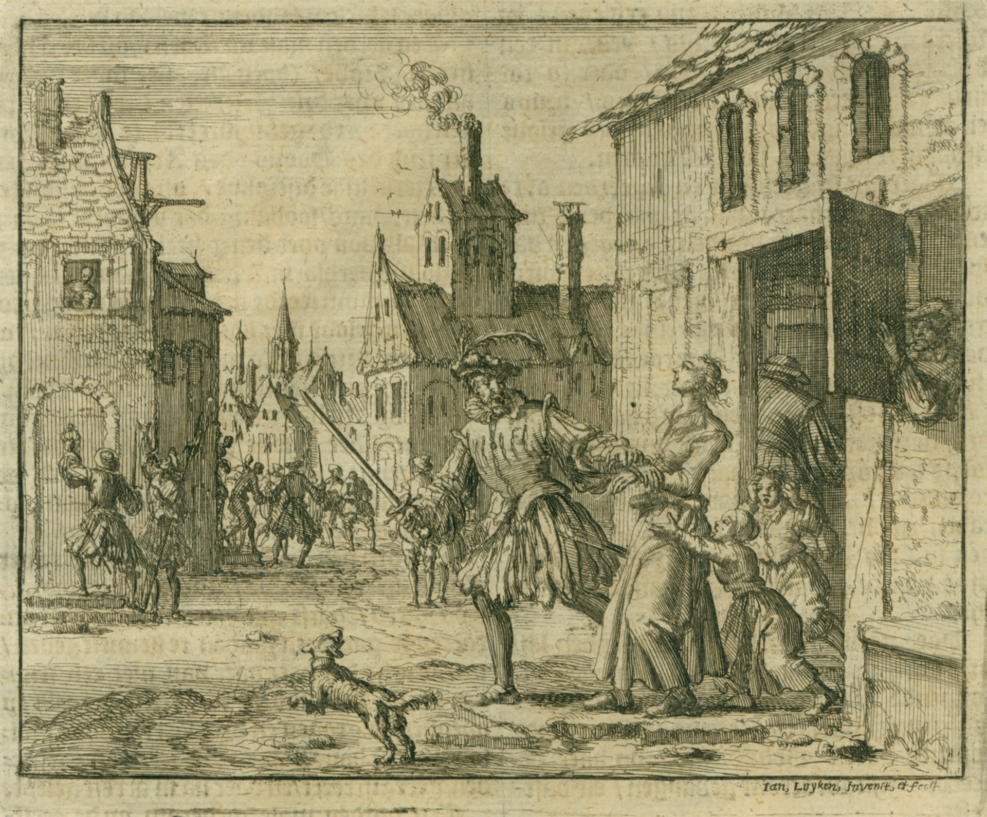
Women
the Württemberg government’s decision that the “propaganda activity of Anabaptist women...through word of mouth [and] through booklets” was so grievous that those “mothers who could not be banished because of their little children must be chained at home to prevent their leading so many people astray.”
One of the friends of Weynken (a widow who was about to be burnt to death in the Hague in 1527)pled with this Anabaptist lady, saying, “Dear mother, can you not think what you please and keep it to yourself? Then you will not die.” Weyken responded, “Dear sister, I am commanded to speak, and am constrained to do so; hence I cannot remain silent about it.” (Martyr’s Mirror.)

Slide 25
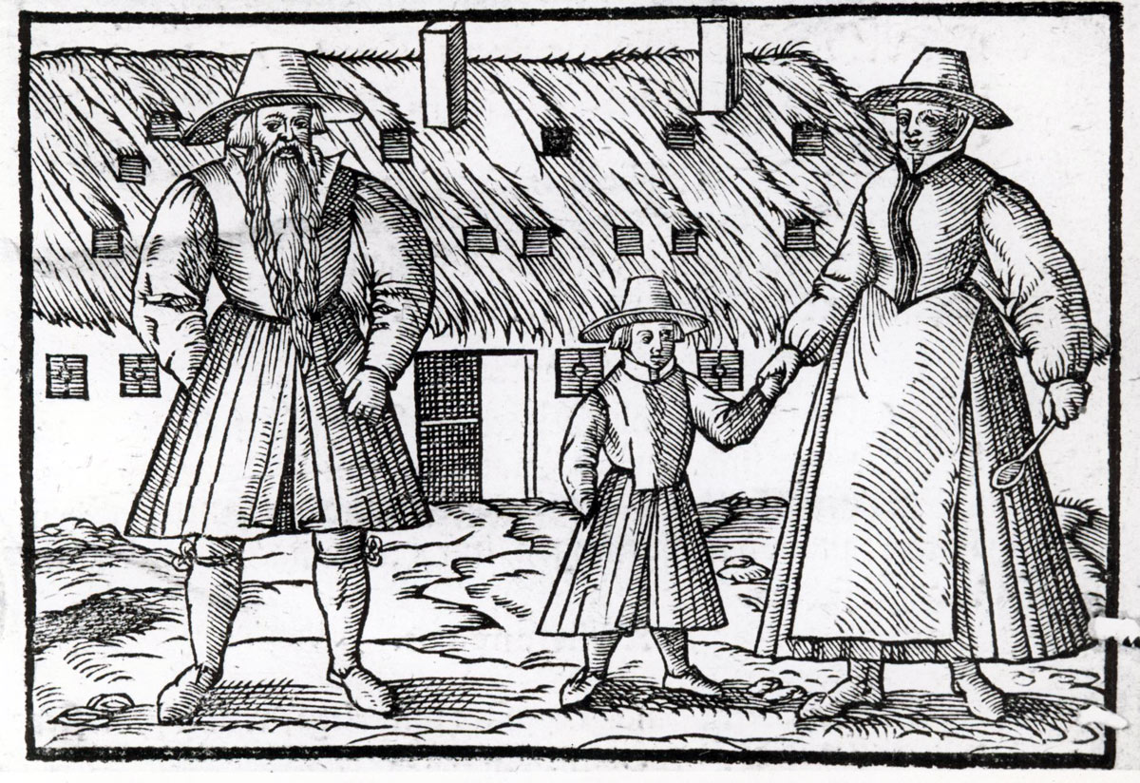
The Swiss Brethren and the Hutterites.
An organized Effort
They "sent brethren every year to lands near and far according to the commandments of Christ and the practice of the apostles, to teach and to preach and to gather for the Lord God's people."
In order to be able to fulfill the task laid upon them by the Lord, the congregation semiannually (usually in the spring and fall) chose from the preachers a number of Brethren to perform a widespread missionary service in all directions, to preach the Gospel in accordance with the commandment of Christ, In these early days of terrible persecution they usually brought these converts back to Moravia with them.
Each missionary had his field assigned to him; thus Brethren went out to all parts of Germany (Bavaria, Württemberg, Hesse, Thuringia, Rhineland, also Silesia and Prussia), to Switzerland, to Poland, and in two cases also to Venice, Italy. A few even came as far as Denmark and Sweden.

Slide 26
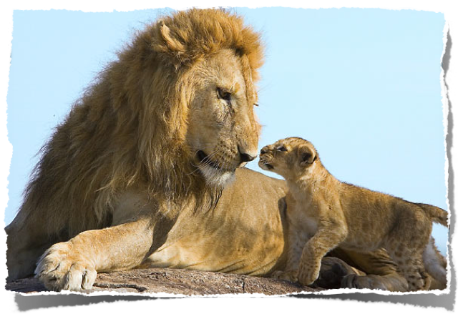
They knew who the enemy was---and They Knew who would Win!
Jeronime Käls, caught on his way between Moravia and South Tyrol, saw the “easy way out” that many Catholic and Protestant people had taken.
Many in our time think the opposition has ended. They look back and think the war is over. But they are deceived, if they would live the Life they would get persecuted again. As long as the lion has its cubs with him he might act friendly and playful enough. But when he loses his little ones, or his prey, he cannot keep himself back. He rages and roars.
He rants and he raves, as only lions can, until fire shoots from his eyes! Certainly Peter does not warn us in vain that Satan comes upon us like a roaring lion or a wolf at nightfall. But, may God be praised, the Lion of the Tribe of Judah is bigger and stronger than the lion of the Philistines. He has already split the other lion’s head and wounded his body. Therefore he knows that his time is short, and he will soon be overcome. Therefore he is so desperate, so angry. He sees the lake of fire into which he will be thrown. Watch yourselves, therefore, heroes of Israel! Take courage, strong men of Zion! Rejoice, oh city of Jerusalem! The time of your triumph is near. All tears will be washed from your eyes. The reward of your labours stands ready. Just hold on a little while longer! The fat cattle have already been butchered, the fowls have all been plucked. The tables stand ready and the guests have begun to arrive!

Slide 27
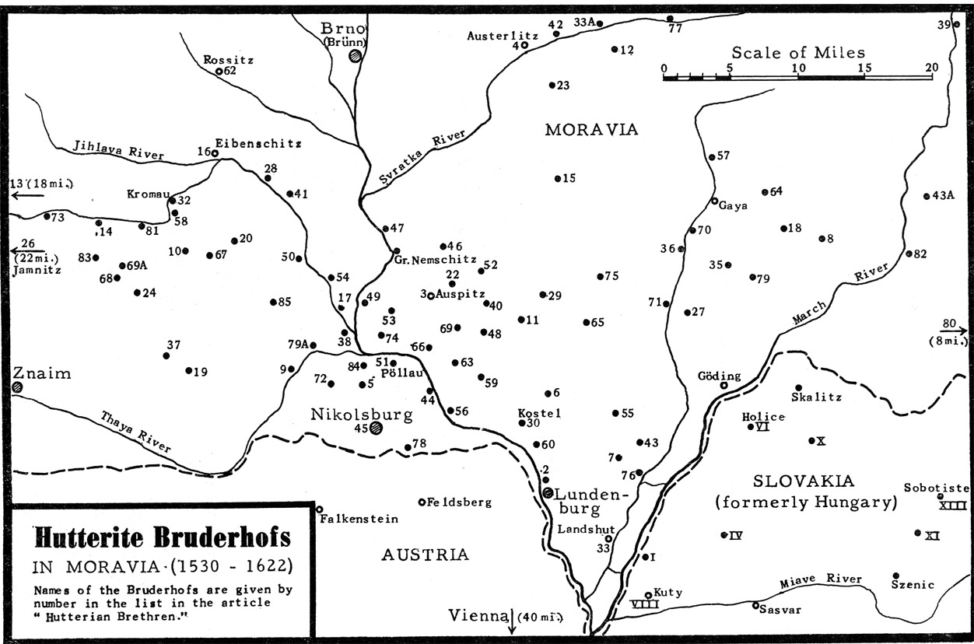
Fruit during times of distress.

Slide 28
The Commission
The Graner Codex which was found in the Brunner Archives describes in some detail an Anabaptist commissioning service. First, the candidates told the congregation how God had called them into the mission work and to the preaching of the Gospel in “other lands.”
This was followed by a session of admonition in which the missionaries asked the congregation to remain faithful in their local tasks of visiting the sick and the imprisoned, of providing for the poor and unemployed, and of remembering them (the missionaries) with prayers and material provisions.
Then the people of the congregation pledged their support, wished them well, and prayed for God’s mercies upon their ministry. Then they would sing.

Slide 29
As God His Son was sending
Into this world of sin,
His Son is now commanding
That we this world should win.
He sends us and commissions
To preach the Gospel clear,
To call upon all nations
To listen and to hear.
To Thee, O God, we’re praying,
We’re bent to do Thy will;
Thy Word we are obeying,
Thy glory we fulfill.
All peoples we are telling
To mend their sinful way,
That they might cease rebelling,
Lest judgment be their pay.
And if Thou, Lord, desire,
And should it be Thy will
That we taste sword and fire
By those who thus would kill,
Then comfort, pray, our loved ones
And tell them, we’ve endured.
And we shall see them yonder
Eternally secured.

Slide 30
Thy Word, O Lord, does teach us,
And we do understand;
Thy promises are with us
Until the very end.
Thou hast prepared a haven
Praised be Thy holy name.
We laud Thee, God of heaven,
Through Christ, our Lord. Amen

Slide 31
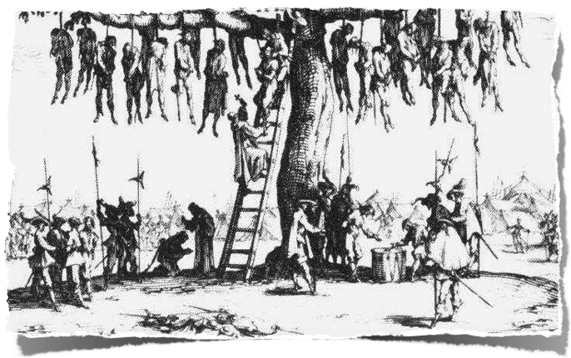
30 Year War
1620: “This year too, we followed the example of our forefathers by sending out several brothers to various places in Germany. They went to seek those on fire for the truth and to call people to repentance. It amazed many people in Bohemia (where both hostile armies were encamped) as well as in Germany that our defenseless members
set out during a time of such terrible danger, when scarcely anyone, whether of high or low estate, could travel in safety. But the Lord was their protector, and they relied on him alone. When their task was completed (through the intercession of his people) , he led them home again in peace and safety.”
Hutterian Chronicles Vol 1, pg 678.

Slide 32
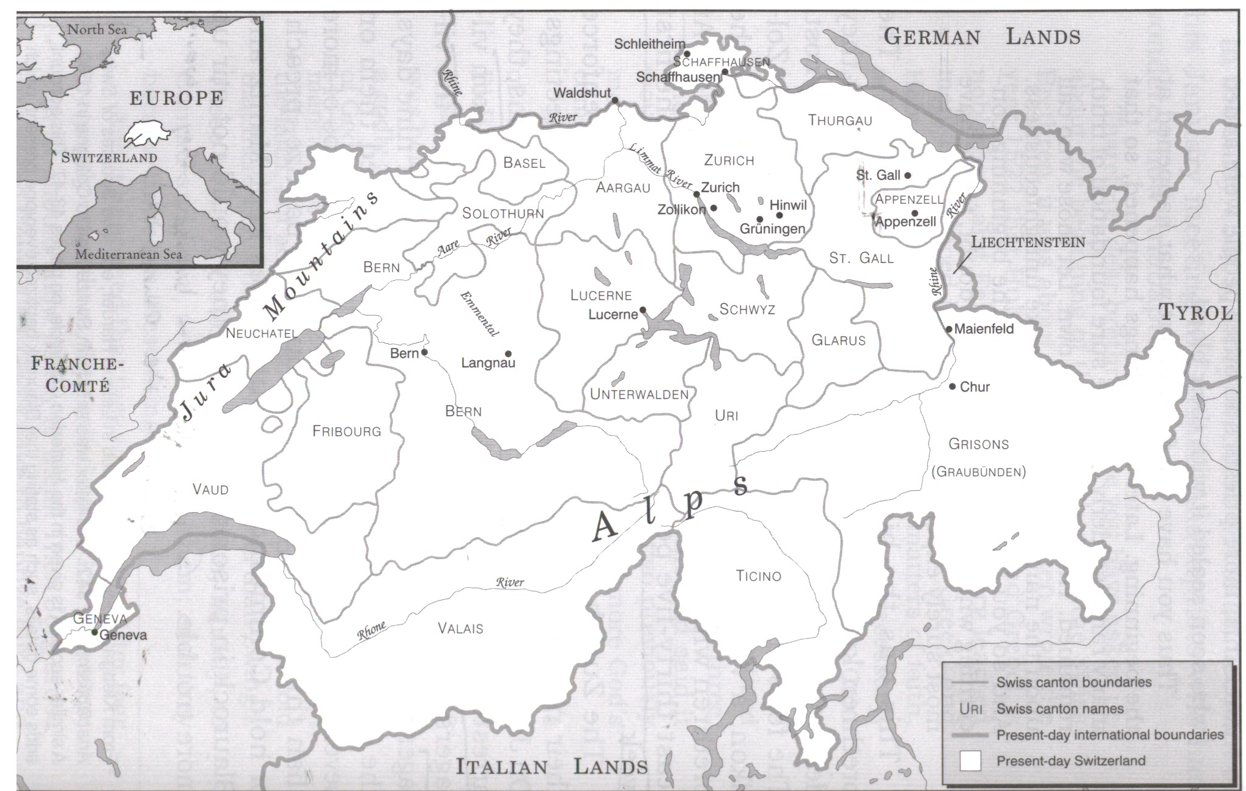

Slide 33
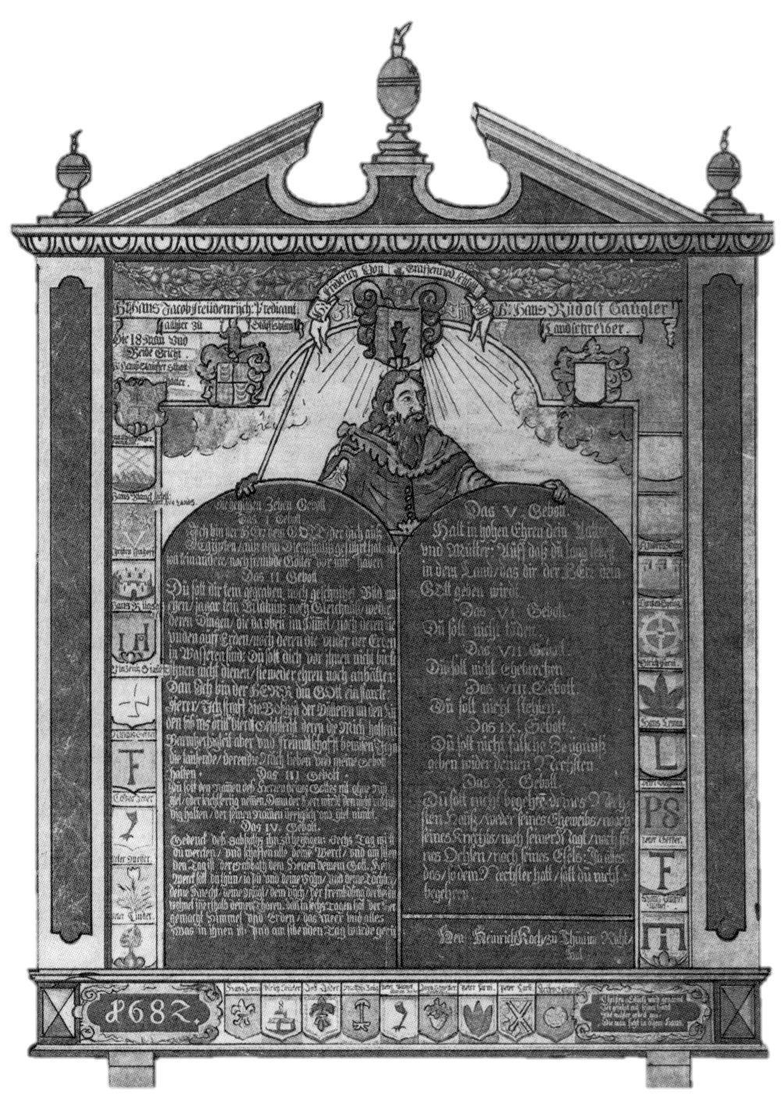
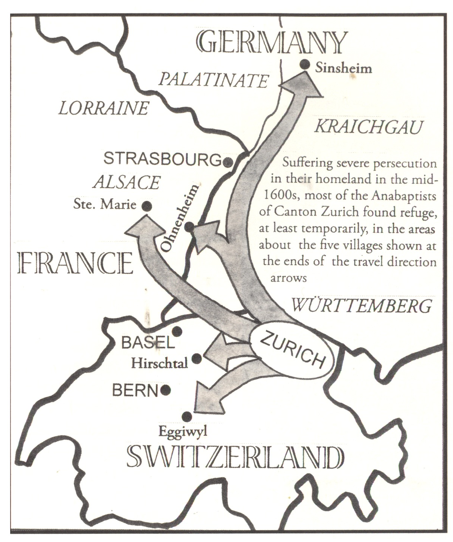

Slide 35

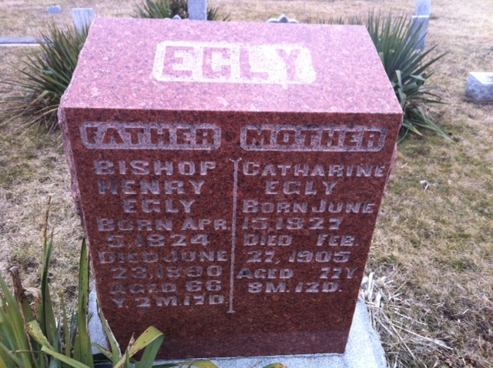
From Berne to the Congo
Mennonites had first come to the Congo in 1912-as pioneer missionaries from the newly formed Egly Amish Church (Defenseless Mennonites) that started after Henry Egly conversion, near Berne Indiana. They had established a “mission base” that would serve as the hub of their outreach to five ethnic groups in the region. From the beginning, the missionaries were committed to learning local languages as the basis for their evangelistic and educational work. Through the years, that sensitivity to local context enabled the steady growth of the church.
Today, the three Congolese Mennonite denominations-the Community of Mennonite Brethren Churches in Congo, the Evangelical Mennonite Community, and the Mennonite Community in Congo-number nearly 200,000 members and are among the fastest growing Mennonite churches in the world.

Slide 36
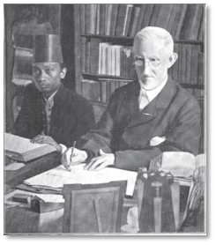
To the Muslims
In 1851 Mennonite congregations in the Netherlands pooled their resources to support the first overseas Mennonite missionaries,
Pieter Jansz and his wife, on a journey to the Netherlands East Indies (Indonesia). There the Janszs and their coworkers established a mission church in north central Java and set about translating the Bible into Javanese and Malay.

Slide 37

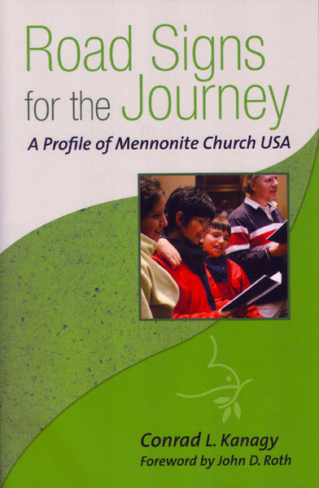
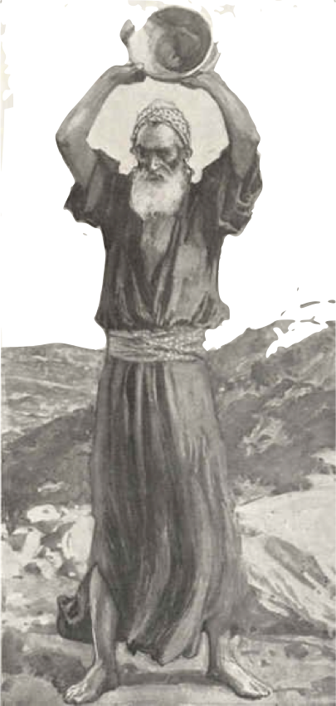
Time to read Jeremiah
Spending time in Jeremiah has strengthened my conviction about the need and opportunity for Mennonites to give a prophetic witness today—to boldly proclaim God’s plan and purpose to the world. But like all prophetic voices, this witness comes most effectively from those whose lives contrast with the values and lifestyles of the larger culture and society—who intentionally challenge the dominant culture narrative. In other words, prophetic voices are most often from the margins of society, from the alienated, disenfranchised, and devalued by those in the middle.

Slide 38
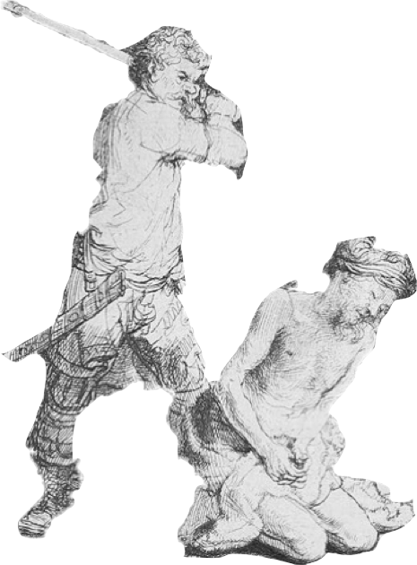
Biblical examples of such prophetic responses from the margins include Jeremiah, John the Baptist, and Jesus Himself. Any relevant and effective call to follow Jesus rarely comes from those in the middle of society—those focused on protecting their power, status, control, and affluence. While Mennonites historically shared a place on the margin of the broader culture, it is clear from the data of Mennonite Member profile 2006 that not many of us—with the exception of Racial/Ethnic members—remain there today. Most Mennonites are more like the broader culture—something our parents and grandparents often referred to as “the world”—than ever before.

Slide 39
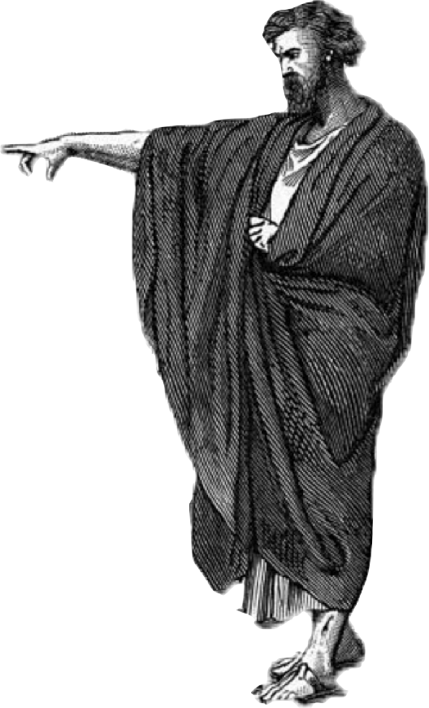
Our inability or unwillingness to step away from the comfortable middle where most North American Christians find themselves today is a primary reason that the church (including Mennonites) has lost its prophetic voice. We have stopped speaking the whole truth about Christ to our neighbors, our friends, our communities, the nation, and the world. Too often when we attempt to do so, it is in diluted, popular language that ensures that we and our potential converts won’t loose our skin over the deal, that nothing too radical will become of such a decision to follow Jesus.

Slide 40
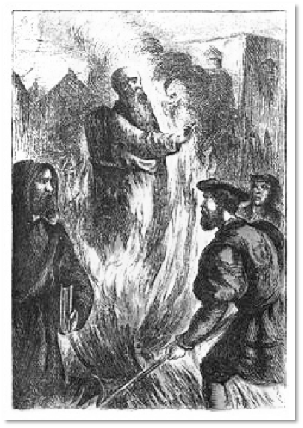
History Stoppers or History Makers?
An old Testament scholar suggest that those in the middle of society and of the church are “history stoppers” rather than “history makers.” History makers, including the prophets, speak on the edges of their culture and society, shouting God’s truth to those in the middle—to the “history stoppers” who are too busy preserving their own position and status to bother with God’s truth. History makers, by speaking the truth, begin to shape and to put into motion the plans and purposes of God. The radical, off –the –wall words of history makers become the foundation for the new thing that God wants to do. The problem is that most of us in North America have achieved our current status by siding with the history stoppers—preserving our position and protecting our investments while watering down the truth about our sinful condition and a costly gospel. The Church in North America is in desperate need of a few more prophetic history makers and a few less pathetic history stoppers.

Slide 41

Decisions and Consequences
20
19
18
17
16
15
14
13
12
11
10
9
8
7
6
5
4
3
2
1
0
5
10
15
20
25
30
35
40
45
50
55
60
65
70
75
80
90

Slide 42
1Ti 5:24 Some men's sins are open beforehand, going before to judgment; and some men they follow after.
Jer 8:20 The harvest is past, the summer is ended, and we are not saved.

Slide 43
Do you see the kingdom?
John 3

